Slide 1
Computer Graphics 5th Recitation “OpenGL intro”
Anna Shtengel
Based on slides by Michael Litvin
13.04.2015

Slide 2
Today!
Color spaces
Intro to OpenGL

Slide 3
Colors
Color models and spaces

Slide 4
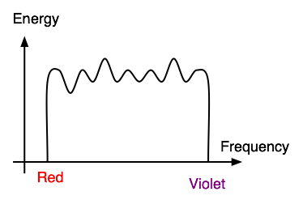
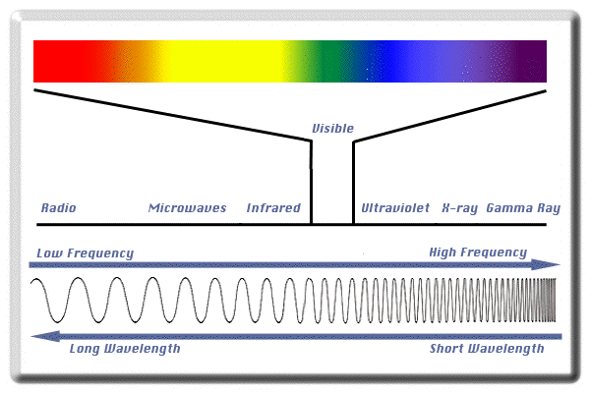
Lights
Light Signal
Amplitude
Frequency
White Light
Visible range
Spectral Colors
Red, Blue, Orange
Non Spectral Colors
White, Gray, Pink

Slide 5
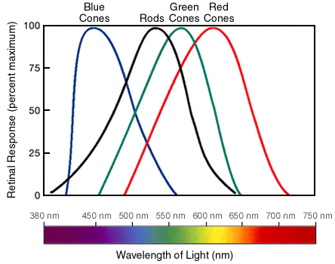
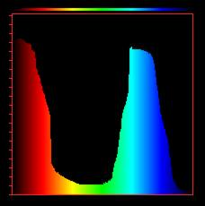
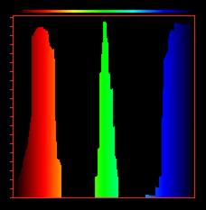
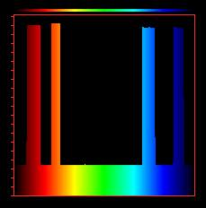

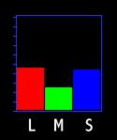
Perceiving Light
How does our brain perceive a light signal?
Integral over signal and response
Metamerism
Different frequency mixtures perceived as same
Reproducing Colors
Example: How to fake Yellow with R G & B lights?
Find the RGB metamer
S M L

Slide 6
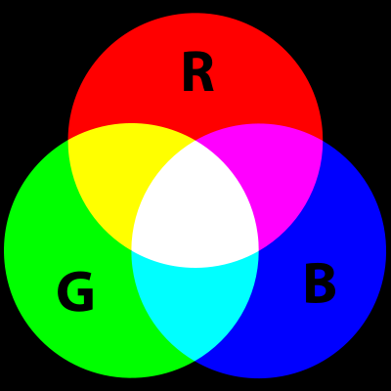
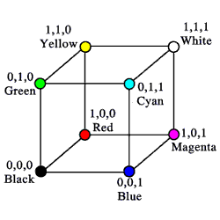
RGB
Additive color model
Light intensities
Used in displays (CRT, LCD)
“Primary colors”:
Red, Green, Blue
Device dependant
different devices detect or reproduce a given RGB value differently

Slide 7
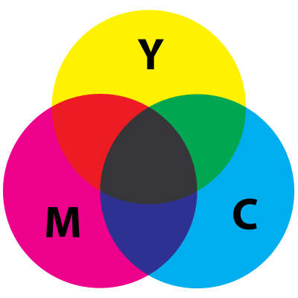
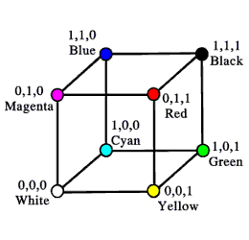
CMY (K)
Subtractive color model
Absorption
Used for printing ink
RGB Complements
Cyan
Yellow
Magenta
K specifies “black”
Used for economic reasons

Slide 8
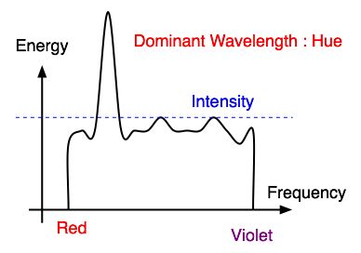
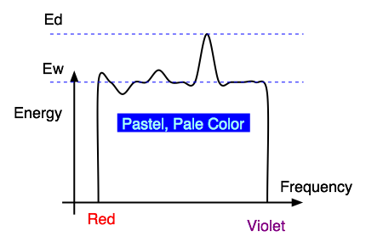
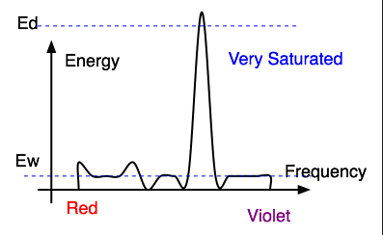
Light Characteristics
Hue
Saturation
Intensity

Slide 9
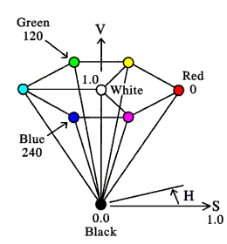
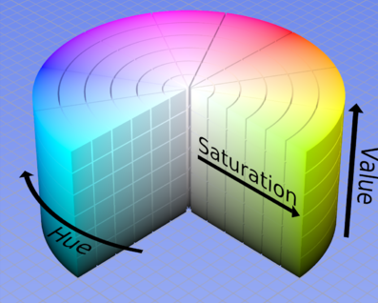
HSV/HSI/HSL
More suitable for describing colors
Hue
Saturation
Value/Intensity/Lightness
Demo
goo.gl/9wGvN
(www.cs.rit.edu/~ncs/color/a_spaces.html)

Slide 10
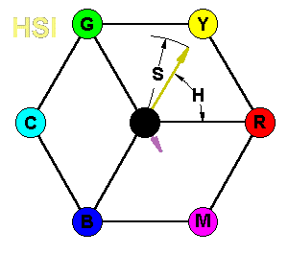
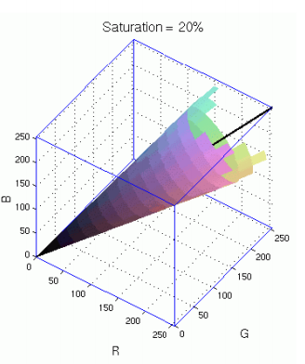
HSI↔RGB
RGB→HSI:
Intensity – Projection to the grayscale line
Saturation – Distance from the grayscale line
Hue – Rotation around grayscale line in respect to Red
Notes:
http://www.way2c.com/colchsil.gif

Slide 11
RGB↔CMY
Conversion is simple:
RGB = (1,1,1) - CMY
Red in CMY = ?
(0,1,1)
Yellow in RGB = ?
(1,1,0)
Mixing Red and Blue inks?
Connect them with a line
(0.5,1,0.5)CMY = (0.5,0,0.5)RGB = Purple

Slide 12
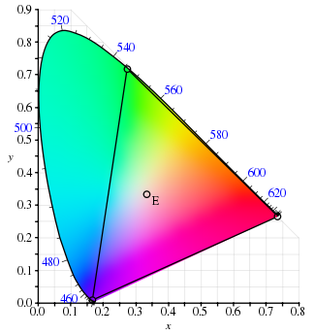
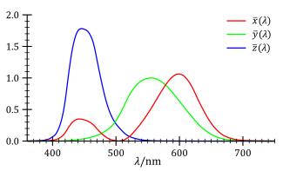
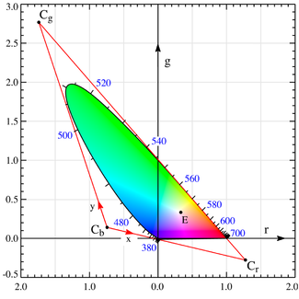
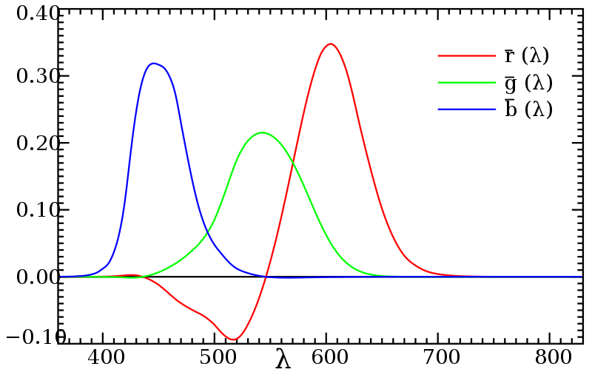
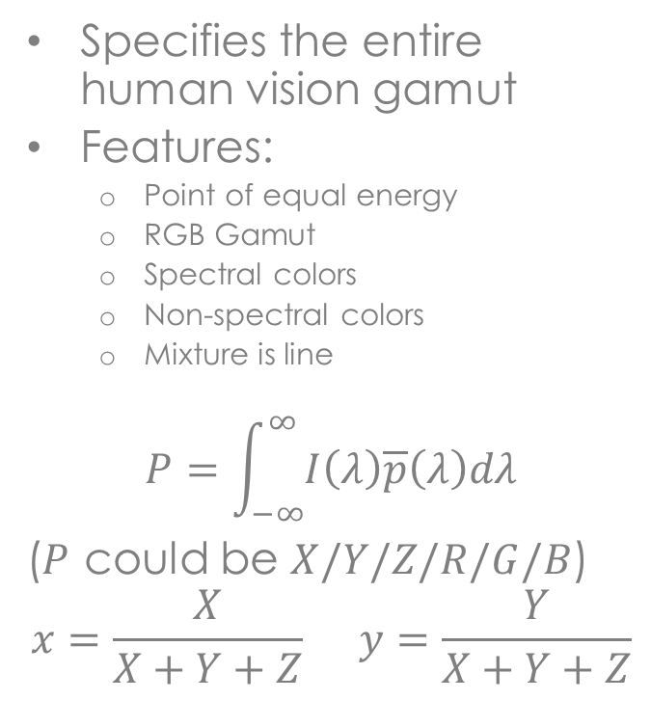
CIE-XYZ/RGB
Specifies the entire human vision gamut
Features:
Point of equal energy
RGB Gamut
Spectral colors
Non-spectral colors
Mixture is line
$$P=\int_{−∞}^{∞}{I\left(λ\right)\overline{p}\left(λ\right)dλ}$$
($P$ could be $X/Y/Z/R/G/B$)
$$x=\frac{X}{X+Y+Z} y=\frac{Y}{X+Y+Z}$$

Slide 13
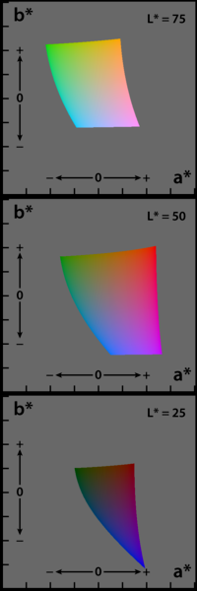
CIE Lab
CIE-XYZ is perceptually non-linear
Lab adjusts it to make it perceptually linear
so that as you move across the chart, the color changes at a constant rate.
Useful for Euclidian color distance calculation
For tristimulus colors it uses
L: Lightness
a: Red-Greeness
b: Yellow-Bluness

Slide 14
Representing Colors
Example: Orange
Wavelength 585–620 nm
#FF7F00
0xFF7F00
(255,127,0)
(30°, 100%, 100%)
java.awt.Color.ORANGE

Slide 15
OpenGL
An Introduction

Slide 16

Open Graphics Library
Software interface to graphics hardware
“The Assembly of computer graphics”
Industry Standard
OpenGL is
Free to use
Free to implement
Cross Platform
OpenGL isn’t
Software Library
Programming Language
Windowing Interface (GUI)

Slide 17
OpenGL Specification
http://www.opengl.org/registry/doc/glspec13.pdf
Defines a Graphical System
State Machine
Graphical Pipeline
Transformation->Clipping->Shading->Rasterization…
Defines an API
Uses the C language
Ports to many other languages exist
Current Version is 4.3
We use version 1.3

Slide 18
A Simplified OpenGL Machine
Application
Graphical Pipeline
Framebuffer
GL
Commands
Pixels
OpenGL

Slide 19
OpenGL Graphical Pipeline
3D Geometric Primitives
Modeling
Transformation
Lighting
Display Lists
Viewing
Transformation
Textures
Projection
Transformation
GLSL
Clipping
Scan
Conversion
Frame Buffer
Notes:
http://upload.wikimedia.org/wikipedia/commons/b/bb/Pipeline_OpenGL_%28en%29.png

Slide 20
OpenGL Implementations
OpenGL library serves as an abstraction layer
Interface is independent of Hardware & OS
Implementation is dependent of Hardware & OS
Implementation can be in Software and/or Hardware
Any part of the Graphical Pipeline can be implemented in either Software or Hardware
What if Hardware doesn’t fully support Interface?
Worst case use Software Implementation
Slow but very robust!

Slide 21





OpenGL Implementations
Driver:
OpenGL32.dll
atioglxx.dll
nvoglv32.dll
libGL.so
(Mesa3D)
Driver:
libGL.so

Slide 22
Examples
goo.gl/Ai3pK
(www.marky.com/3d/quake2/compare/content.html)

Slide 23
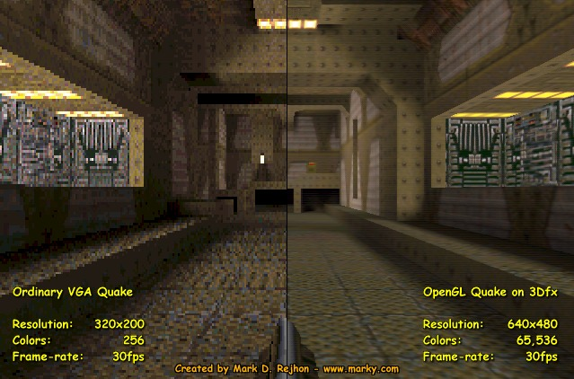

Slide 24
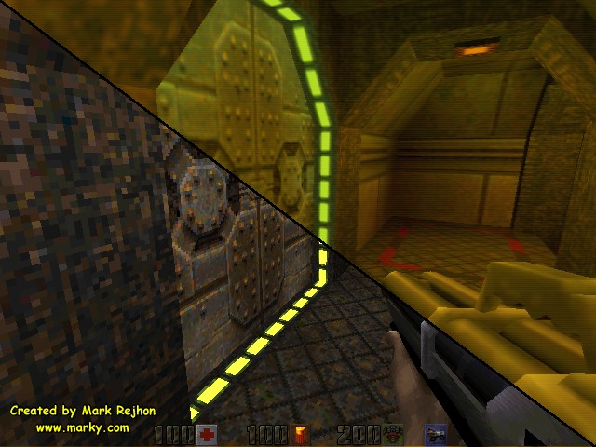

Slide 25
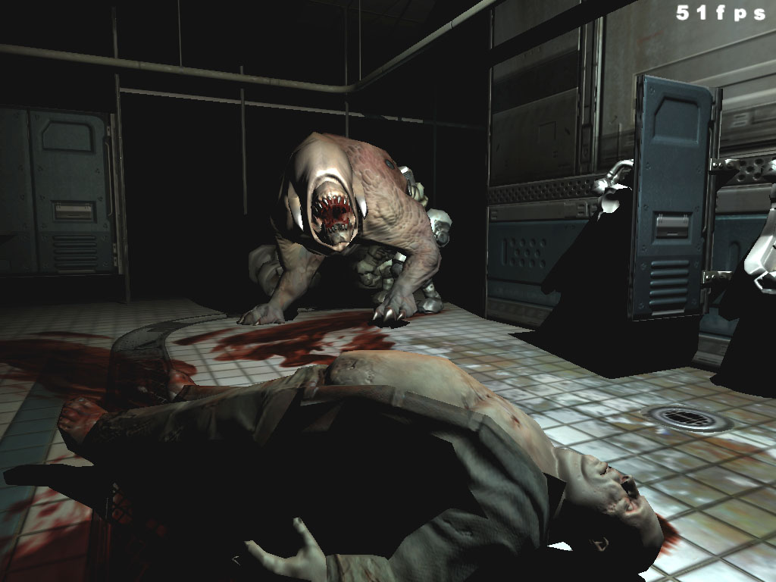

Slide 26
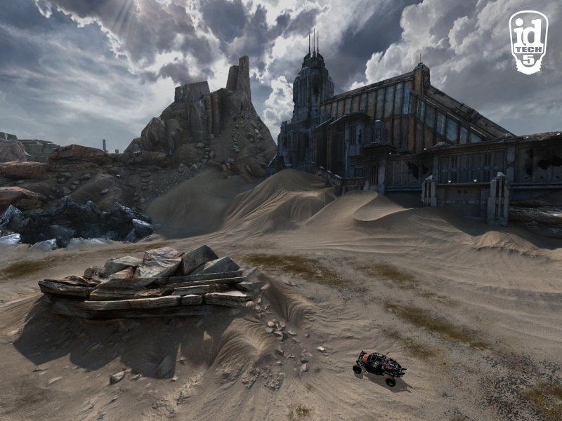

Slide 27

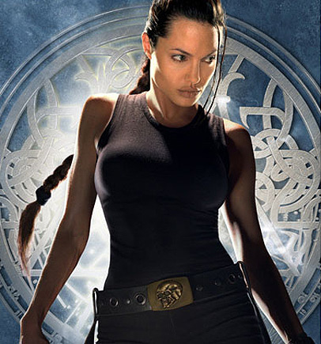

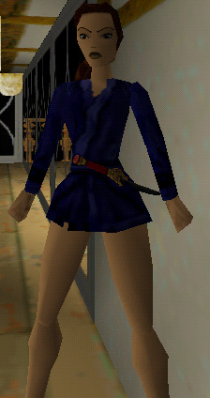



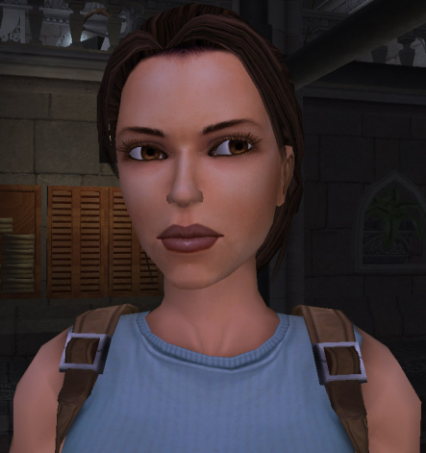

With time-GPUs improves and quality comes along
TR2
TR4
TR1-1996
TR3
Taken from presentation by Guy Benyei guy.benyei@intel.com

Slide 28
Programming OpenGL
An Introduction

Slide 29
Command Syntax
gl.glFunction{#=2,3,4}{T=i,f,d,…}(...);
gl.glVertex3f(1.0f, 2.0f, 3.0f);
gl.glVertex2i(1,1);
gl.glRotated(90.0, 0.0, 0.0, 1.0);
gl.glFunction#Tv(float *v);
float v[] = {1.0f, 2.0f, 3.0f};
gl.glVertex3fv(v);
GL.GL_CONSTANT
gl.glEnable(GL.GL_DEPTH_TEST);
gl.glClear(GL.GL_COLOR_BUFFER_BIT);

Slide 30
OpenGL as a State Machine
An OpenGL Context is a State Machine
“State” is a system variable that remains fixed until the user changes it
Examples:
Current Color
Current Transformation Matrix
Current light positions and their attributes
OpenGL context is initialized with defined default values

Slide 31
Changing General States
Setting States
Almost every OpenGL function:
glColor3f() – Current Color
glNormal3f() – Current Normal
glMatrixMode() – Current Transformation Matrix
glLineWidth() – Line width rasterization
glLightf() – Lighting attributes
glMaterial() – Material
Getting States
glGet(…)
GL_CURRENT_COLOR, GL_CURRENT_NORMAL, GL_MATRIX_MODE,GL_LINE_WIDTH, GL_LIGHT1 ...
Expansive call – avoid using

Slide 32
Changing Boolean States
Setting States:
glEnable(), glDisable()
Examples:
GL_DEPTH_TEST
GL_LIGHTING
GL_LIGHT1
GL_CULL_FACE
Getting States:
glIsEnabled()
Expansive call – avoid using

Slide 33
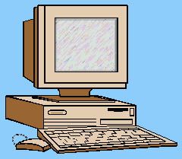
Partial List of States
GL_CURRENT_COLOR GL_EDGE_FLAG_ARRAY_POINTER GL_MODELVIEW_MATRIX
GL_PROJECTION_MATRIX GL_TEXTURE_MATRIX GL_VIEWPORT
GL_DEPTH_RANGE GL_MODELVIEW_STACK_DEPTH GL_PROJECTION_STACK_DEPTH
GL_TEXTURE_STACK_DEPTH GL_MATRIX_MODE GL_NORMALIZE
GL_CLIP_PLANE GL_FOG_COLOR GL_FOG_INDEX
GL_FOG_DENSITY GL_FOG_START GL_FOG_END
GL_FOG_MODE GL_FOG GL_SHADE_MODEL
GL_LIGHTING GL_COLOR_MATERIAL GL_COLOR_MATERIAL_PARAMETER
GL_COLOR_MATERIAL_FACE GL_AMBIENT GL_DIFFUSE
GL_SPECULAR GL_EMISSION GL_SHININESS
GL_LIGHT_MODEL_AMBIENT GL_LIGHT_MODEL_LOCAL_VIEWER GL_LIGHT_MODEL_TWO_SIDE
GL_CURRENT_INDEX GL_CURRENT_TEXTURE_COORDS GL_CURRENT_NORMAL
GL_CURRENT_RASTER_POSITION GL_CURRENT_RASTER_DISTANCE GL_CURRENT_RASTER_COLOR
GL_CURRENT_RASTER_INDEX GL_CURRENT_RASTER_TEXTURE_COORDS GL_CURRENT_RASTER_POSITION_VALID
GL_EDGE_FLAG GL_VERTEX_ARRAY GL_VERTEX_ARRAY_SIZE
GL_VERTEX_ARRAY_TYPE GL_VERTEX_ARRAY_STRIDE GL_VERTEX_ARRAY_POINTER
GL_NORMAL_ARRAY GL_NORMAL_ARRAY_TYPE GL_NORMAL_ARRAY_STRIDE
GL_NORMAL_ARRAY_POINTER GL_COLOR_ARRAY GL_COLOR_ARRAY_SIZE
GL_COLOR_ARRAY_TYPE GL_COLOR_ARRAY_STRIDE GL_COLOR_ARRAY_POINTER
GL_INDEX_ARRAY GL_INDEX_ARRAY_TYPE GL_INDEX_ARRAY_STRIDE
GL_INDEX_ARRAY_POINTER GL_TEXTURE_COORD_ARRAY GL_TEXTURE_COORD_ARRAY_SIZE
GL_TEXTURE_COORD_ARRAY_TYPE GL_TEXTURE_COORD_ARRAY_STRIDE GL_TEXTURE_COORD_ARRAY_POINTER
GL_EDGE_FLAG_ARRAY GL_EDGE_FLAG_ARRAY_STRIDE
AND LOTS OTHERS …

Slide 34
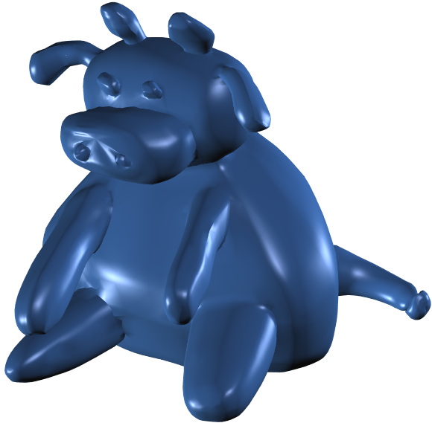
Example
// set the current color to blue.
glColor3f(0.0f, 0.0f, 1.0f);
// render the cow.
renderCow();
// set the current color to green.
glColor3f(0.0f, 1.0f, 0.0f);
// render ground.
renderGround();
Current Color

Slide 35
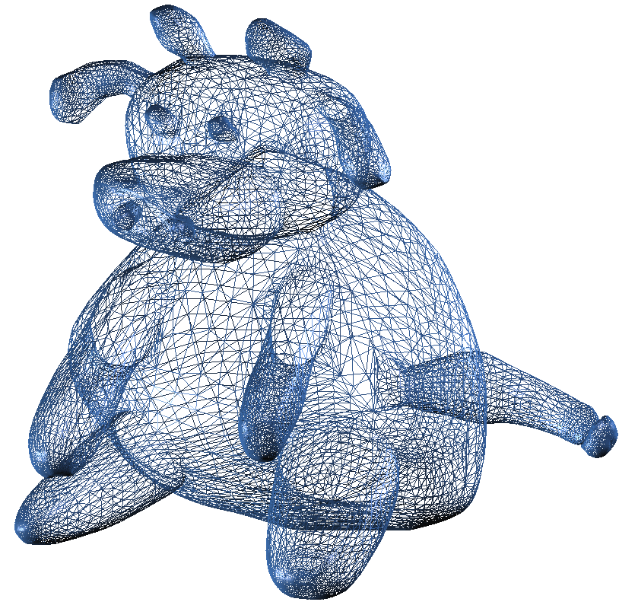
OpenGL as a State Machine
Remember, OpenGL remains in the same states until changed!
The cow is modeled with ~25K triangles, all in the same color. You need to call glColor only once
Notes:
מאוד יעיל בביצועים, אבל נורא מתודולוגית. קשה לדבג

Slide 36
JOGL
Using OpenGL from Java

Slide 37
JOGL = Java OpenGL
Java binding to OpenGL API
Currently a community driven project
We will use JOGL version 1.1.1a
Built upon OpenGL 1.3
V2.0 is in beta, and is built upon OpenGL 4

Slide 38
Programming JOGL
GLDrawable – Rendering target interface
AWT implementation: GLCanvas
Swing implementation: GLJPanel
GL – OpenGL interface
All OpenGL commands are exposed by the GL class
Instance obtained from GLDrawable objects:
GL gl = drawable.getGL();
gl.glClearColor(0, 0, 0, 1);
gl.glClear(GL.GL_COLOR_BUFFER_BIT);
Notes:
http://download.java.net/media/jogl/doc/userguide/
GLDrawable is the abstract class of GLJCanvas and GLJPanel
glClearColor specifies clear color value to the buffers

Slide 39
GLEventListener
To draw you must handle GLDrawable events exposed by GLEventListener:
display – Use this for drawing (similar to Java’s paint())
init – Use to initialize relevant objects (e.g. display timer)
reshape – Called whenever the component resizes. Use it for adjusting viewport and projection
displayChanged – Unimplemented in JOGL, reserved for future use, to know when display mode or device change.

Slide 40
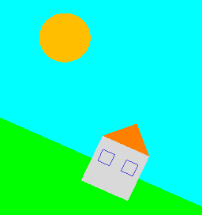
Example
Setup JOGL (guide: goo.gl/z4MIY)
The file is in the moodle for you to play
Set color state using
gl.glColor3d(double r, double g, double b);
Set polygon rasterization mode using
gl.glPolygonMode(GL.GL_FRONT_AND_BACK, GL.GL_LINE);
gl.glPolygonMode(GL.GL_FRONT_AND_BACK, GL.GL_FILL);
Translate and scale
gl.glTranslated(double x, double y, double z)
gl.glScaled(double x, double y, double z)

Slide 41
public class App implements GLEventListener {
public static void main(String[] args) {
App app = new App();
// AWT Init
Frame frame = new Frame();
GLCanvas canvas = new GLCanvas();
frame.setSize(500, 500);
frame.setLayout(new BorderLayout());
frame.add(canvas,BorderLayout.CENTER);
// Event handling
canvas.addGLEventListener(app);
frame.addWindowListener(new WindowAdapter() {
@Override
public void windowClosing(WindowEvent e) {
System.exit(0);
super.windowClosing(e);
}
});
// Display GUI
frame.setVisible(true);
}

Slide 42
public void display(GLAutoDrawable e) {
GL gl = e.getGL();
gl.glClearColor(0, 0, 0, 1);
gl.glClear(GL.GL_COLOR_BUFFER_BIT);
// Animate – global transformation for the scene
animate(gl);
// Draw scene
// Ground
gl.glPolygonMode(GL.GL_FRONT_AND_BACK, GL.GL_FILL);
gl.glColor3d(0, 1, 0);
drawSquare(gl, 0, -10, 10);
…
}
Notes:
drawable.setGL(new javax.media.opengl.DebugGL(drawable.getGL()));
-installs GL pipeline

Slide 43
public void init(GLAutoDrawable drawable) {
drawable.setGL(new javax.media.opengl.DebugGL(drawable.getGL()));
// Setup animation callback to call display 60 times per second
FPSAnimator ani = new FPSAnimator(60, true);
ani.add(drawable);
ani.start();
…
}
public void reshape(GLAutoDrawable drawable, int x, int y,
int width, int height) {}
public void displayChanged(GLAutoDrawable drawable,
boolean modeChanged, boolean deviceChanged) {}
}

Slide 44
private double frame = 0;
private void animate(GL gl) {
frame++;
gl.glLoadIdentity();
double s = (Math.cos(frame/100));
gl.glRotated(s*30, 0, 0, 1);
s = (s+1)/2;
s = (1-s)*1/5 + s*1;
gl.glScaled(s, s, s);
}
private void drawSquare(GL gl, double x, double y, double s) {
gl.glPushMatrix();
gl.glTranslated(x, y, 0);
gl.glScaled(s, s, 0);
gl.glBegin(GL.GL_POLYGON);
{
gl.glVertex2d(-1, -1);
gl.glVertex2d(1, -1);
gl.glVertex2d(1, 1);
gl.glVertex2d(-1, 1);
}
gl.glEnd();
gl.glPopMatrix();
}

Slide 45
Resources
nehe.gamedev.net (Especially the legacy tutorials section)
www.felixgers.de/teaching/jogl
Notes:
jogamp.org/wiki/index.php/Jogl_Tutorial

Slide 46
Exercise 3
Any questions?

